Slide 1
Scikit Learn
Dr. Rakhee Chhibber

Slide 2
Link for documentation
https://scikit-learn.org/stable/

Slide 3
Introduction
Scikit-learn is an open-source Python library that simplifies the process of building machine learning models. It offers a clean and consistent interface that helps both beginners and experienced users work efficiently.
Supports tasks like classification, regression, clustering and preprocessing
Makes model building fast and reliable
Provides ready-to-use tools for training and evaluation
Reduces complexity by avoiding manual implementation of algorithms

Slide 4
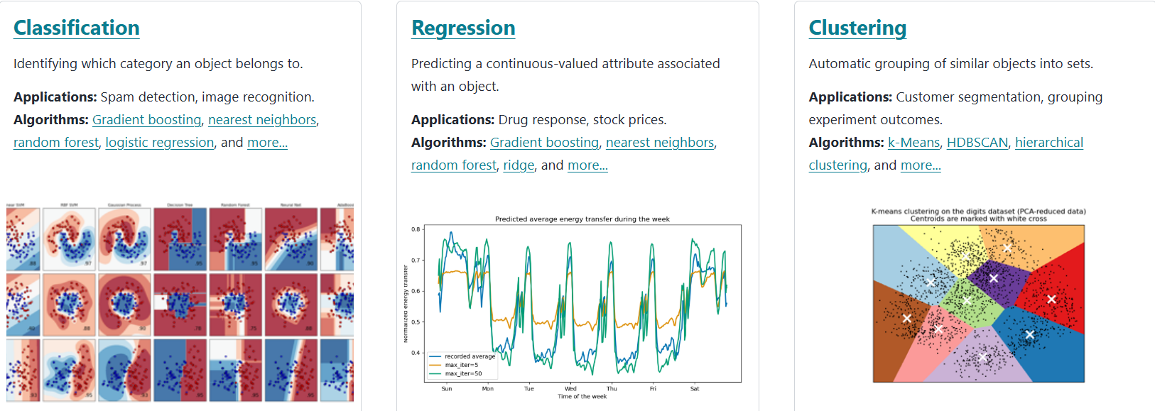

Slide 5
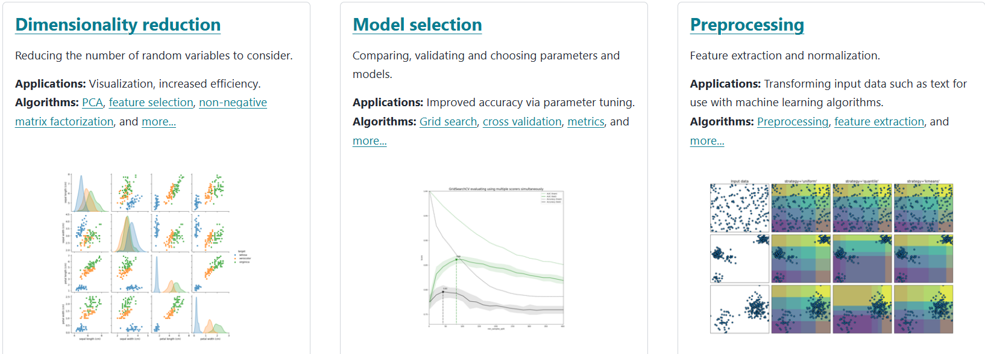

Slide 6
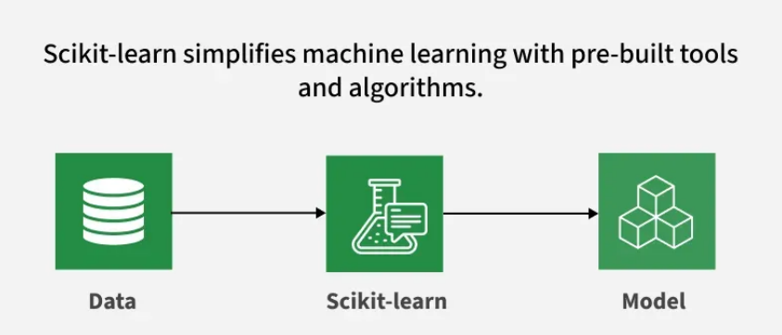

Slide 7
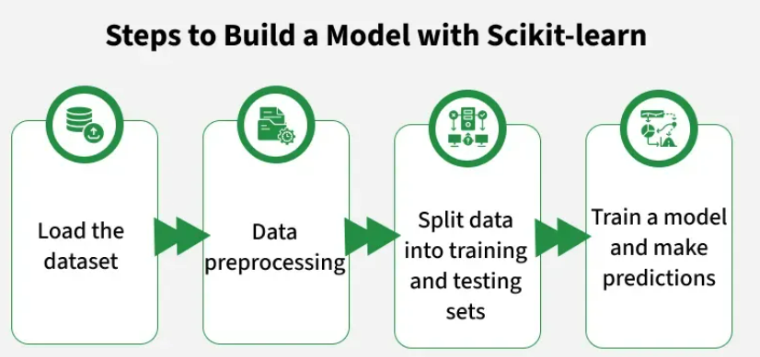

Slide 8
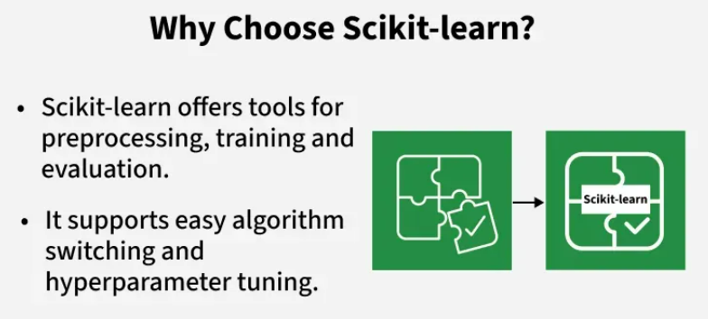

Slide 9
Step 1: Loading a Dataset
A dataset consists of:
Features (X): Input variables that describe the data
Target (y): The value we want to predict
Scikit-learn provides built-in datasets like Iris, Digits and Boston Housing. Using the Iris dataset:
load_iris() loads the data
X stores feature data
y stores target labels
feature_names and target_names give descriptive names

Slide 10
from sklearn.datasets import load_iris
iris = load_iris()
X = iris.data
y = iris.target
feature_names = iris.feature_names
target_names = iris.target_names
print("Feature names:", feature_names)
print("Target names:", target_names)
print("\nType of X is:", type(X))
print("\nFirst 5 rows of X:\n", X[:5])

Slide 11
Step 2: Splitting the Dataset
To evaluate a model fairly, we split data into:
Training set: Used to train the model
Testing set: Used to evaluate how well the model generalizes
Using train_test_split, we split the Iris dataset so that 60% is for training and 40% for testing (test_size=0.4). random_state=1 ensures reproducibility.
After splitting, we get:
X_train, y_train -> Training data
X_test, y_test -> Testing data

Slide 12
from sklearn.model_selection import train_test_split
X_train, X_test, y_train, y_test = train_test_split(X, y, test_size=0.4, random_state=1)
print("X_train Shape:", X_train.shape)
print("X_test Shape:", X_test.shape)
print("Y_train Shape:", y_train.shape)
print("Y_test Shape:", y_test.shape)

Slide 13
Step 3: Handling Categorical Data
1. Label Encoding:
2. One-Hot Encoding:

Slide 14
Step 4: Training the Model
Now that our data is ready, it’s time to train a machine learning model. Scikit-learn has many algorithms with a consistent interface for training, prediction and evaluation. Here we’ll use Logistic Regression as an example.
Note: We will not go into the details of how the algorithm works as we are interested in understanding its implementation only.
log_reg = LogisticRegression(max_iter=200): Creating a logistic regression classifier object.
log_reg.fit(X_train, y_train): Using this the logistic regression model adjusts the model’s parameters to best fit the data.

Slide 15
from sklearn.linear_model import LogisticRegression
log_reg = LogisticRegression(max_iter=200)
log_reg.fit(X_train, y_train)

Slide 16
Step 5: Make Predictions
Once trained we use the model to make predictions on the test data X_test by calling the predict method. This returns predicted labels y_pred.
log_reg.predict: It uses trained logistic regression model to predict labels for the test data X_test.
y_pred = log_reg.predict(X_test)

Slide 17
Step 6: Evaluating Model Accuracy
Check how well our model is performing by comparing y_test and y_pred. Here we are using the metrics module's method accuracy_score.
from sklearn import metrics
print("Logistic Regression model accuracy:", metrics.accuracy_score(y_test, y_pred))
Logistic Regression model accuracy: 0.9666666666666667
Now we want our model to make predictions on new sample data. Then the sample input can simply be passed in the same way as we pass any feature matrix. Here we used it as sample = [[3, 5, 4, 2], [2, 3, 5, 4]]

Slide 18
sample = [[3, 5, 4, 2], [2, 3, 5, 4]]
preds = log_reg.predict(sample)
pred_species = [iris.target_names[p] for p in preds]
print("Predictions:", pred_species)
Predictions: [np.str_('virginica'), np.str_('virginica')]

Slide 19
Features of Scikit-learn
Ready-to-Use Tools: built-in functions for common tasks like data preprocessing, training models and making predictions.
Easy Model Evaluation: With tools like cross-validation and performance metrics it helps to measure how well our model works and identify areas for improvement.
Wide Algorithm Support: It offers many popular machine learning algorithms including classification, regression and clustering which gives us flexibility to choose the right model for our problem.
Smooth Integration: Built on top of important Python libraries like NumPy and SciPy so it fits into our existing data analysis workflow.
Simple and Consistent Interface: The same straightforward syntax works across different models helps in making it easier to learn and switch between algorithms.
Model Tuning Made Easy: Tools like grid search help us fine-tune our model’s settings to improve accuracy without extra hassle.

Slide 20
Benefits of using Scikit-learn
User-Friendly: Scikit-learn’s consistent and simple interface makes it accessible for beginners and best for experts.
Time-Saving: Pre-built tools and algorithms reduce development time which allows us to focus more on solving problems than coding details.
Better Model Performance: Easy-to-use tuning and evaluation tools helps in improving model accuracy and reliability.
Flexible and Scalable: Supports a wide range of algorithms and integrates smoothly with other Python libraries helps in making it suitable for projects of any size.
Strong Community Support: A large, active community ensures regular updates, extensive documentation and plenty of resources to help when we get stuck.

Slide 21
Questions
Display the first 5 rows of the dataset.
Show summary statistics (describe()).
Check data types of all columns.
Count missing values in the dataset.
Find all rows where the category is Electronics.
Get orders with quantity greater than 1.
Sort the dataset by unit_price descending.
Show orders placed after Jan 20, 2024.
Create a new column total_price = quantity × unit_price.
Add a column showing day of week from order_date.
Replace the region names with uppercase text.

Slide 22
Answers
import pandas as pd
df = pd.read_csv("sales_data.csv", parse_dates=["order_date"])
df.head()
df.describe()
df.dtypes
df.isna().sum()
df[df["category"] == "Electronics"]
df[df["quantity"] > 1]
df.sort_values("unit_price", ascending=False)
df[df["order_date"] > "2024-01-20"]
df["total_price"] = df["quantity"] * df["unit_price"]
df["day_of_week"] = df["order_date"].dt.day_name()
df["region_upper"] = df["region"].str.upper()

Slide 23
Questions
Calculate total revenue per region.
Find total quantity sold for each category.
Which customer spent the most overall?
What is the average unit price per product?
Identify the top 3 most expensive orders.
Find customers who made more than one purchase.
For each category, compute:
total revenue
average quantity
number of unique customers
Pivot the table to show region vs category total revenue.
Convert the dataset into monthly revenue summary (resample by month).

Slide 24
df.groupby("region")["total_price"].sum()
df.groupby("category")["quantity"].sum()
df.groupby("customer")["total_price"].sum().sort_values(ascending=False)
df.groupby("product")["unit_price"].mean()
df.nlargest(3, "total_price")
df["customer"].value_counts()[lambda x: x > 1]
df.groupby("category").agg(
total_revenue=("total_price", "sum"),
avg_quantity=("quantity", "mean"),
unique_customers=("customer", "nunique")
)
df.pivot_table(
index="region",
columns="category",
values="total_price",
aggfunc="sum"
)
df.set_index("order_date").resample("M")["total_price"].sum()

Slide 25
Thank You

